Slide 1
Chapter 7
Decentralized control
Process Control
Dr. Cai Wenjian

Slide 2
Outline – Chapter 7
Preliminary Considerations
  General Concepts
  Advantages and disadvantages of Decentralized Control
  Classic decentralized control methods
Biggest Log Modulus Method
  BLT method for SISO systems
  BLT method for MIMO systems
Equivalent Transfer Function methods
  Equivalent Transfer Functions
  Determine Equivalent Transfer Functions for Integrity
  Controller Design
Comparison Study
Process Control
Dr. Cai Wenjian

Slide 3
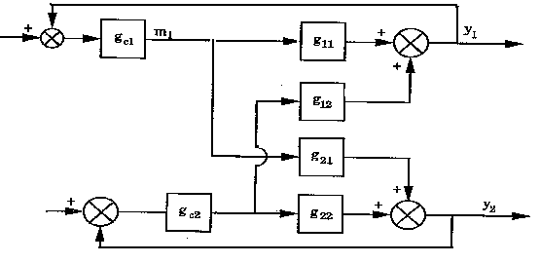
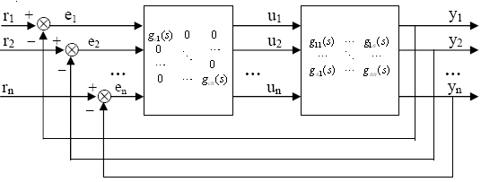
Multi-loop Control Systems
Differences in SISO and interactive MIMO systems:
Manipulated variables that satisfy desired controlled variables must be determined simultaneously.
Differences between single variable and multivariable behavior increase as transmission interaction increases.
Sensitivity of adjustments in manipulated variables to model changes can be much greater in multi-loop than in single loop systems.
Process Control
Dr. Cai Wenjian

Slide 4
Advantages of Decentralized Control
Flexibility and fault tolerance
Independent design of SISO regulators allowed with easier online tuning.
Cost of implementation significantly lower.
Far fewer tuning parameters, significant in the time and cost reduction.
Easier to understand by operators.
Less sensitive to uncertainty
Lighter computation load.
DCS and PLC standard equipment can be applied.
Process Control
Dr. Cai Wenjian

Slide 5
Disadvantages of Decentralized Control
May not work in strongly coupled systems
Optimal solution is very difficult mathematically and may be of infinite order and non-unique
A number of pairing option become big when system dimension is high
Lack of flexibility for interaction adjustment
Few powerful tools for controller design compared with general multivariable control
Process Control
Dr. Cai Wenjian

Slide 6
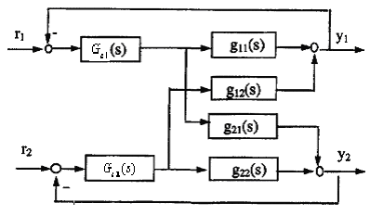
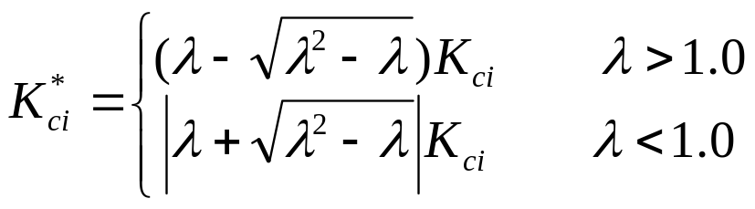
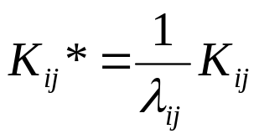
Design by Detuning Factor
Effects of interaction on tuning by RGA, reflected by detuning correlation
Procedure:
Use any single-loop tuning rules to obtain starting values for individual controllers; let controller gains be K_{ci}.
These gains should be reduced depend on relative gain parameter λ
It may still be necessary to “retune” these controllers after they have been put in operation. much less effort than starting from scratch.
Process Control
Prof. Cai Wenjian

Slide 7
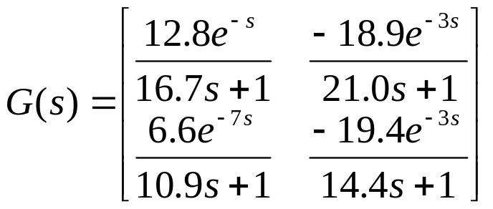
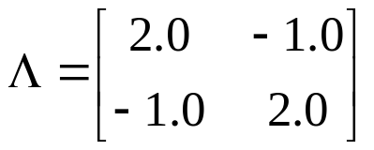

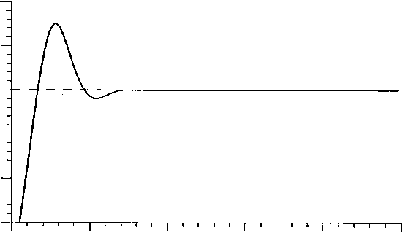
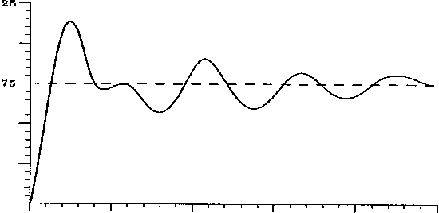
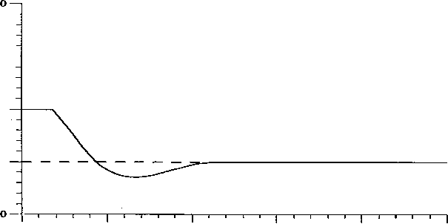
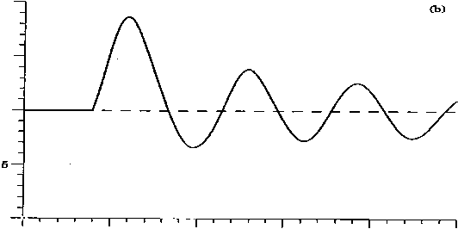
Example: WB Distillation Column
The transfer function:
RGA
1-1/2-2 loop pairing is indicated.
By tuning individual loops with the other loops open, Ziegler-Nichols tuning gives
other loop open
other loop closed
Process Control
Prof. Cai Wenjian

Slide 8

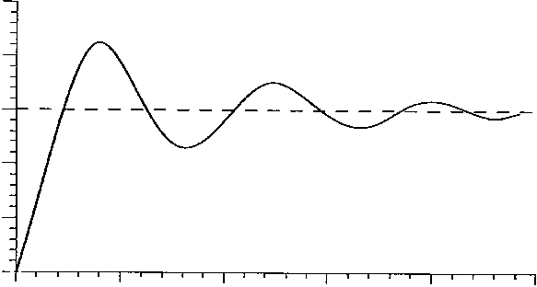
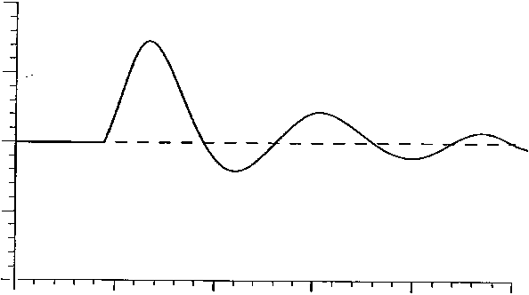
Example: WB Distillation Column
Detune, for λ=2, the original controller gains multiplied by a factor of 0.59
The process is stable and has better closed-loop response.
They could be further improved by continued adjust of parameters.
Process Control
Prof. Cai Wenjian

Slide 9
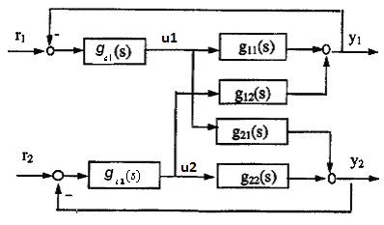
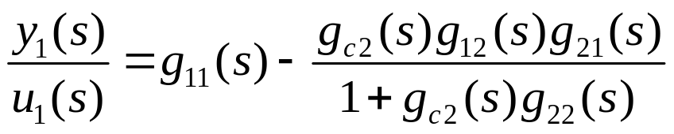
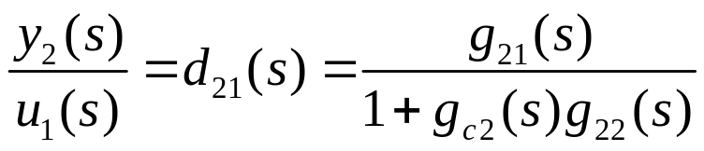
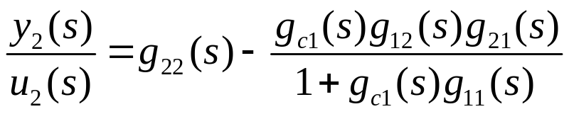
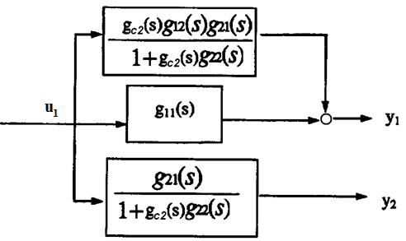
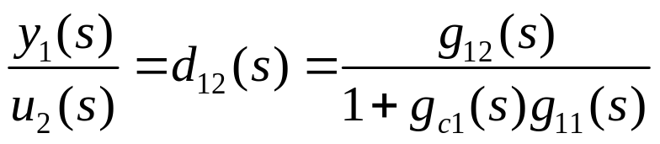
Structure Decomposition
Process Control
Prof. Cai Wenjian

Slide 10
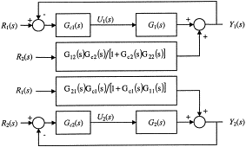
Structure Decomposition
System can be separated into two SISO systems
Tuning of one controller depends on the other controller.
A set-point change on one loop seen as a disturbance by the other.
Process Control
Prof. Cai Wenjian

Slide 11
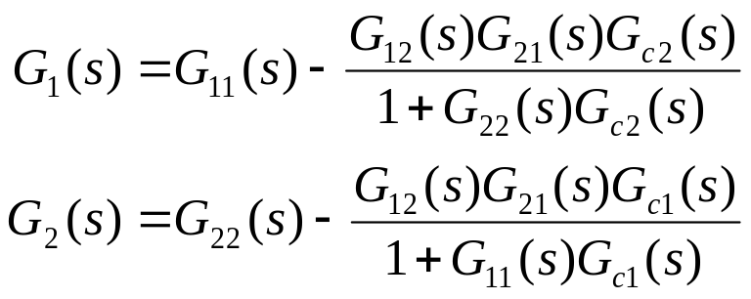

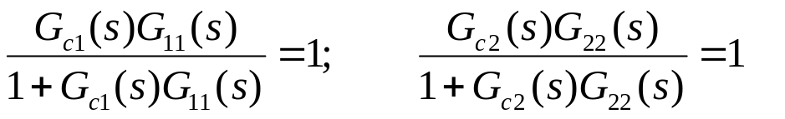
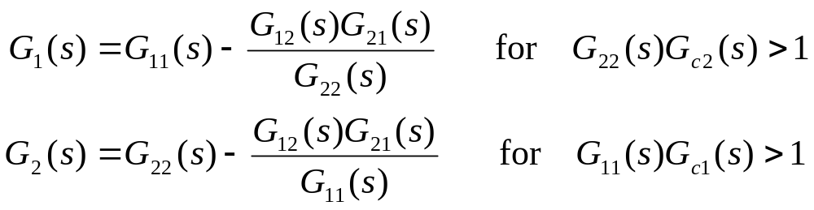
Approximation One
Assumption: Diagonal transfer functions contain no unstable zero, both delay shorter than
Argument: controllers designed so two loops have perfect control with infinite bandwidth or infinite control gains
So that
Process Control
Prof. Cai Wenjian

Slide 12
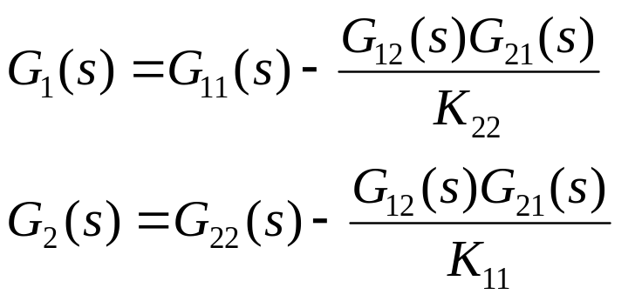
Approximation Two
The transfer functions contain an unstable zero
or a delay longer than
following approximation can be used
Process Control
Prof. Cai Wenjian

Slide 13
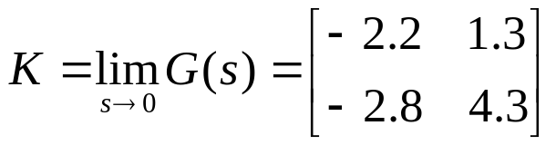
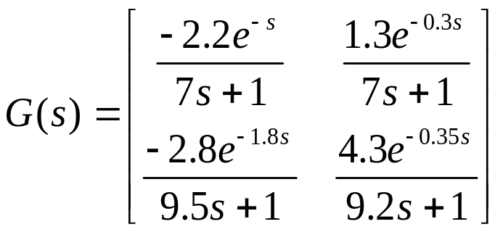
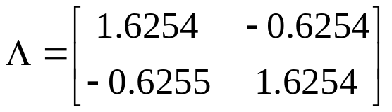
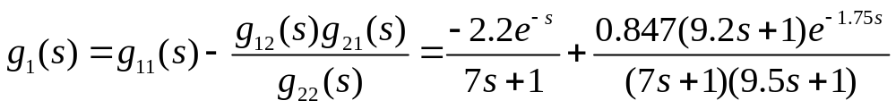
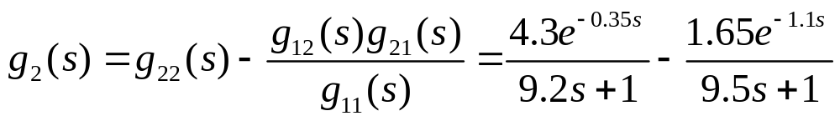
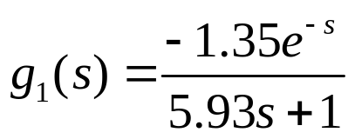
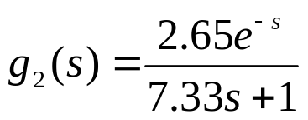
Example: Distillation Column
Each loop simplify to
Process Control
Prof. Cai Wenjian

Slide 14
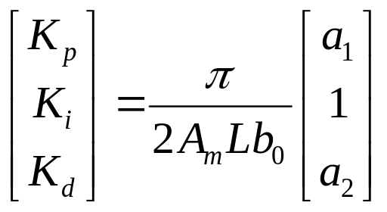
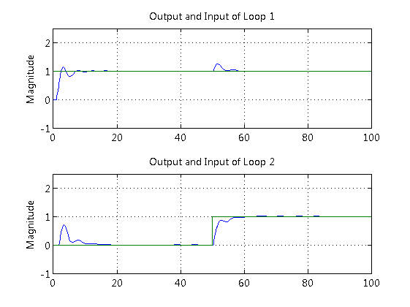
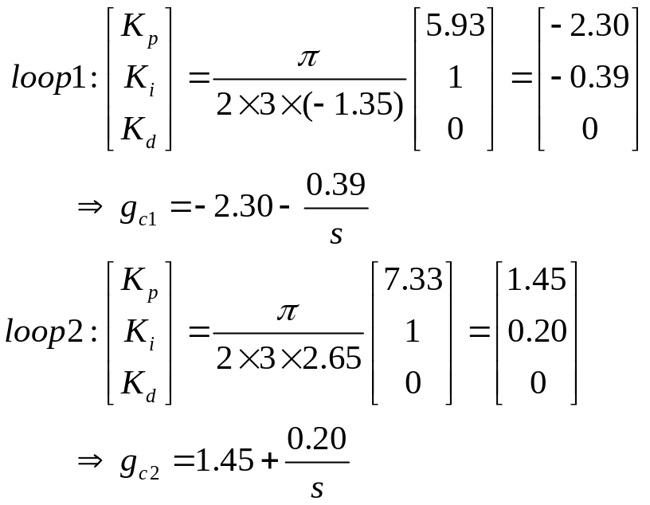
Example: Distillation Column
Gain and phase margin method
Process Control
Prof. Cai Wenjian

Slide 15


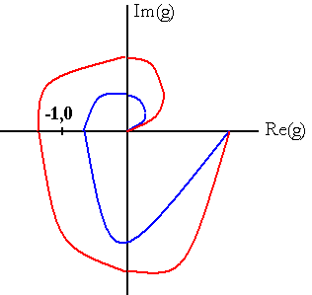
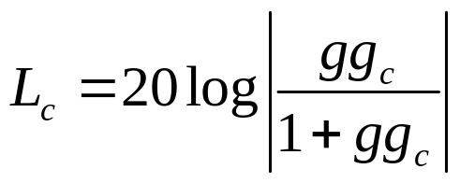
BLT Method Review
Nyquist (Bode or Nichols) plot
made as
from zero to infinity
Number of encirclements of (−1, 0) equal to number of closed-loop characteristic equations roots lie in right half of the s plane if the open-loop system is stable.
If (−1, 0) is encircled, closed-loop system is unstable.
closed-loop log modulus (Lc^{max})
measure distance
from the (−1, 0) point
Farther away from (−1, 0), more stable
A commonly used specification is +2 dB for Lc^{max}
Process Control
Dr. Cai Wenjian

Slide 16


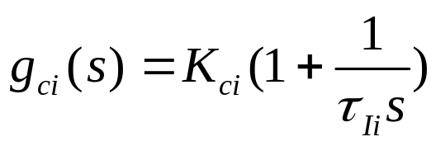
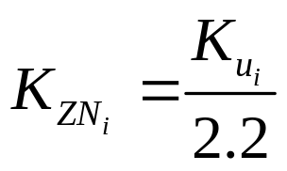
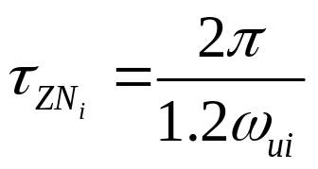

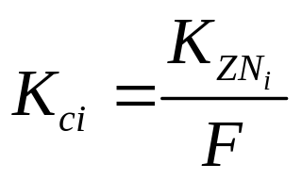
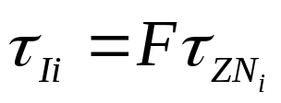
BLT Method for MIMO Processes
Design procedure
1. Calculate the Ziegler-Nichols setting for each individual loop. Ultimate gain K_{u} and ultimate frequency
of each diagonal transfer function
calculated in SISO way.
2. Specify factor F, vary from 2 to 5, all feedback controllers gains (K_{c}) and integral constant
calculated by correcting as
Process Control
Dr. Cai Wenjian

Slide 17



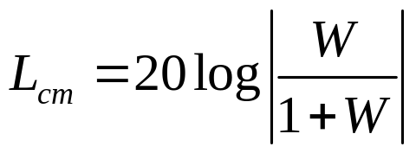
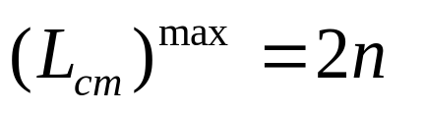
BLT Method for MIMO Processes
3. Define a scalar function
Multivariable closed-loop log modulus
4. For MIMO processes, the best tuning criterion
Process Control
Dr. Cai Wenjian

Slide 18

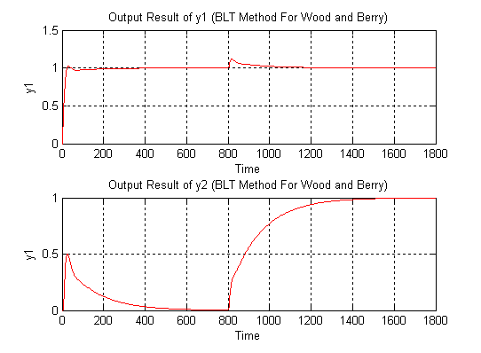

Example: WB Distillation Column
Controller | K_{c,ii}
Loop 1 | 0.375 | 8.29
Loop 2 | −0.075 | 23.6
Process Control
Dr. Cai Wenjian

Slide 19
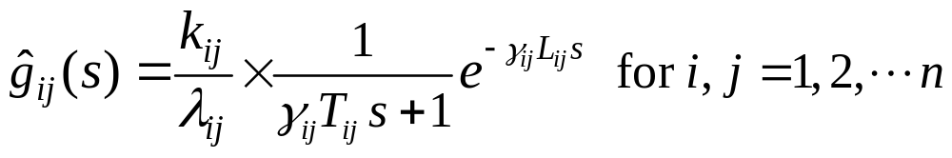
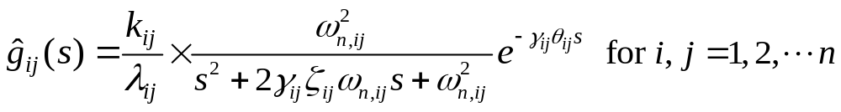
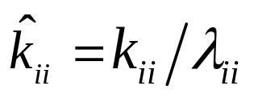
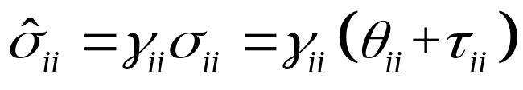
Equivalent Transfer Functions
EFT based on RNGA
Integrity: controller is no more aggressive than SISO without interaction
Process Control
Dr. Cai Wenjian

Slide 20
ETF integrity in Decentralized Control
Flexibility: bring subsystems in and out for service, very important for decentralized control
Failure tolerance: without readjustment to the other parts of the control system, stability can be preserved in the case of any sensor failure and/or actuator failure.
Control integrity: decentralized control should be stabilized by controller with integral action and maintain stability case of sensors and/or actuators failures.
Integrity means even interaction in favor of control performance; up tune the controllers are prohibited.
Process Control
Dr. Cai Wenjian

Slide 21
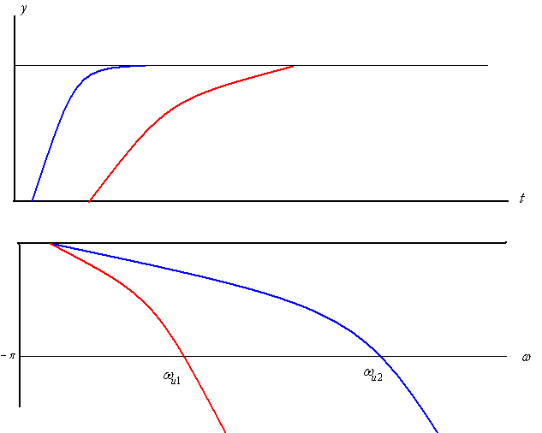
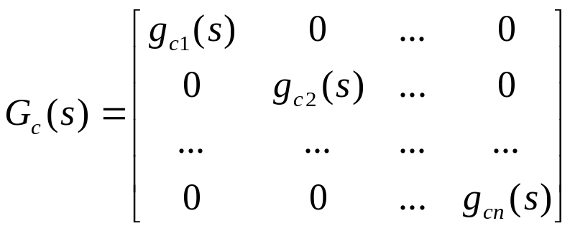
Time and frequency Domains Relations
Smaller NIE → Bigger phase crossover frequency
Bigger NIE → Smaller phase crossover frequency
Diagonal controller structure
Process Control
Dr. Cai Wenjian

Slide 22







Principle on Design Decentralized Controller
Original
EFT
Integrity: controller is no more aggressive than SISO without interaction
Select maximum
Why?
Select maximum
Why?
Phase cross over frequency
Process Control
Dr. Cai Wenjian

Slide 23






Case 1
Steady state gain: when other loops closed, bigger than other loops open. need to be increased in ETF to reduce the controller gain for stability
Other loops closed ART is smaller than that of when other loops open. The smaller ART make the critical frequency shift to the right, increase the phase margin. Need to be kept as before for integrity
Process Control
Dr. Cai Wenjian

Slide 24





Case 2
Steady state gain: same as in Case 1
ART other loops closed is bigger than other loops open. The enlarged ART make the critical frequency shift to the left and reduce the phase margin
ART determined
First order process
Process Control
Dr. Cai Wenjian

Slide 25





Case 3
Steady state gain: when the other loops closed smaller than when other loops open. controller gain cannot enlarged due to integrity consideration
ART when the other loops closed is smaller than when other loops open
same as in Case 1
Process Control
Dr. Cai Wenjian

Slide 26





Case 4
Gain: same as in Case 3
same as in Case 2
Process Control
Dr. Cai Wenjian

Slide 27


ETF Summary
Parameter change
ETFs
Process Control
Dr. Cai Wenjian

Slide 28

ETF Summary
Parameter change
Process Control
Dr. Cai Wenjian

Slide 29










Example
,
Process Control
Dr. Cai Wenjian

Slide 30


Simulation
,
Process Control
Dr. Cai Wenjian

